Slide 1
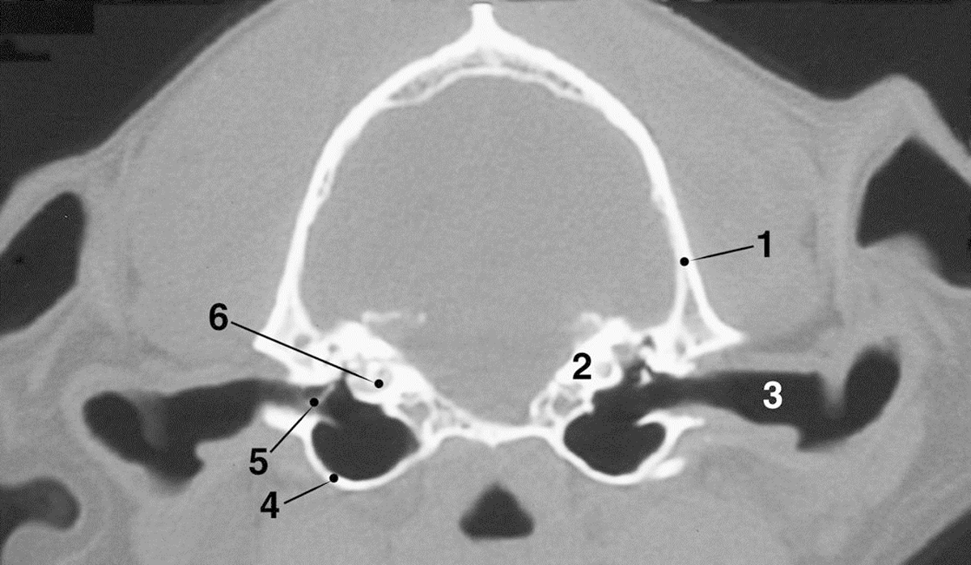
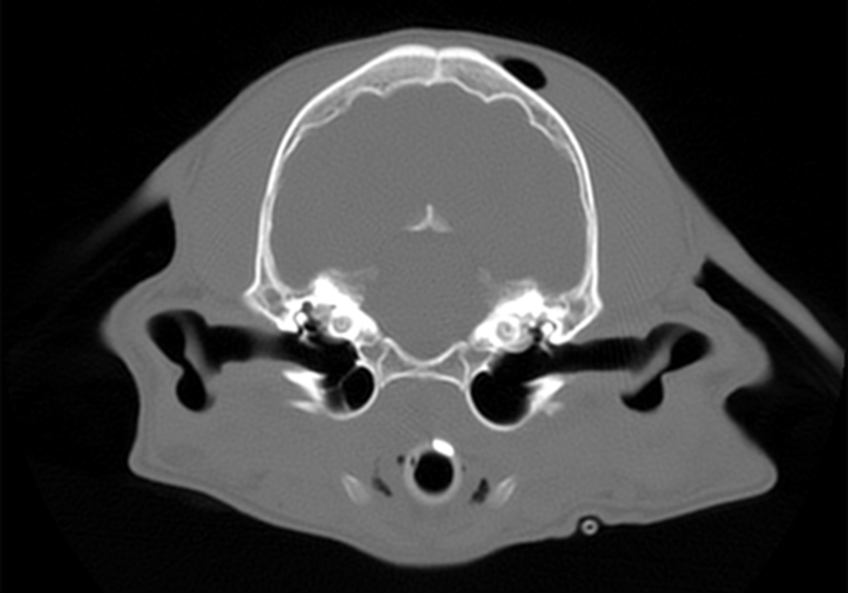
Normal CT
Fig. 5-18 CT image of external acoustic meatus and tympanic cavity.
1. Squamous temporal bone 4. Tympanic bulla
2. Petrous part of temporal bone 5. Malleus at tympanum
3. External acoustic meatus 6. Cochlea
Evans and de Lahunta, Guide to the Dissection of the Dog

Slide 2
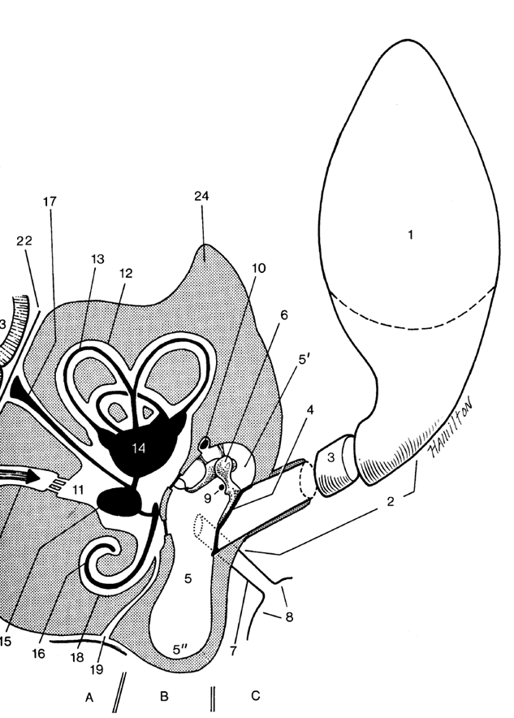
Normal CT

Slide 3
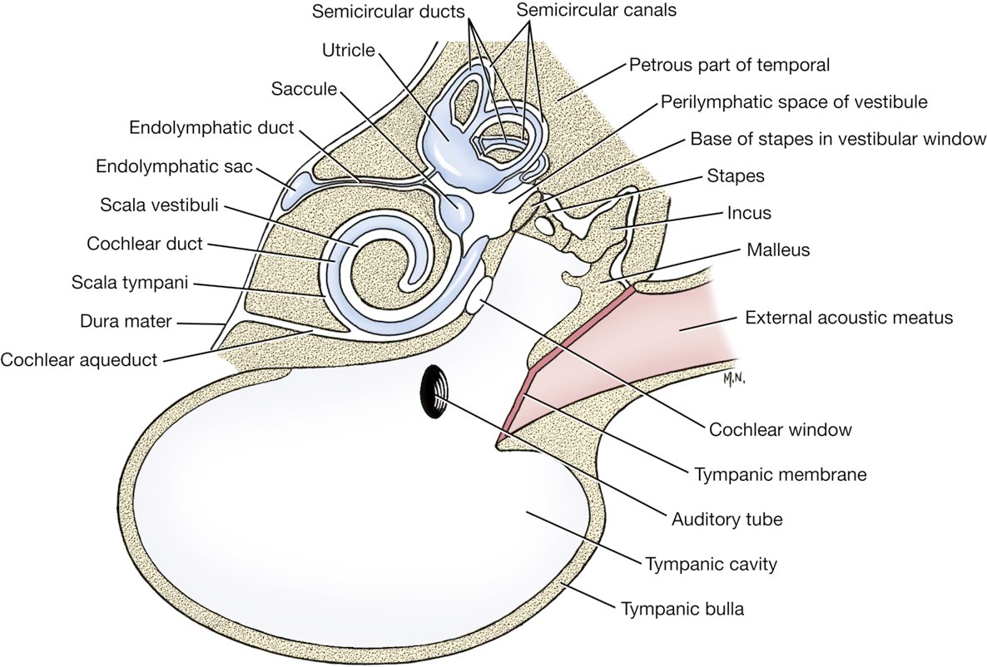
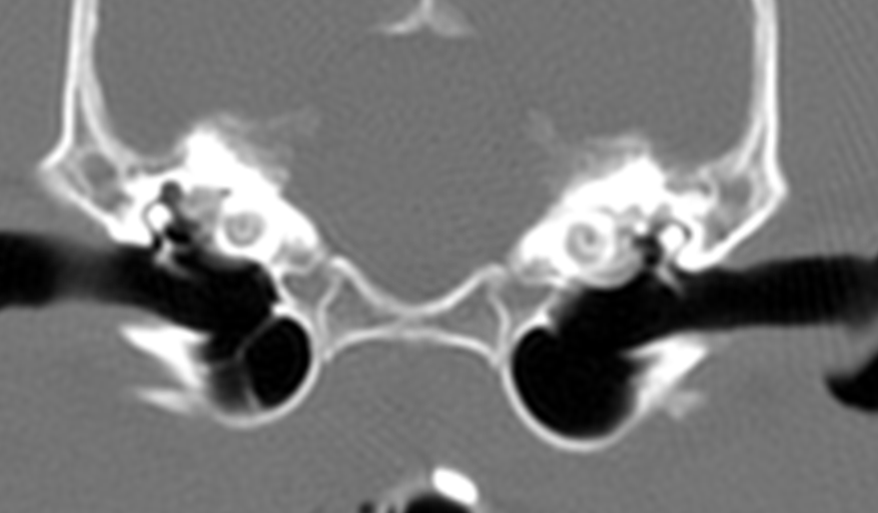
Normal CT

Slide 4
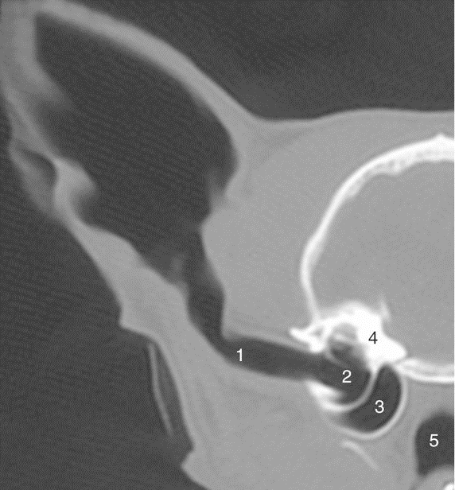
Normal CT
Figure 11-42 Transverse CT scan (bone window) of half of a feline head showing ear canal and middle ear.
1, ear canal 2, tympanic cavity
3, tympanic bulla 4, petrous temporal bone
5, nasopharynx.
Dyce Textbook of Veterinary Anatomy

